Slide 1
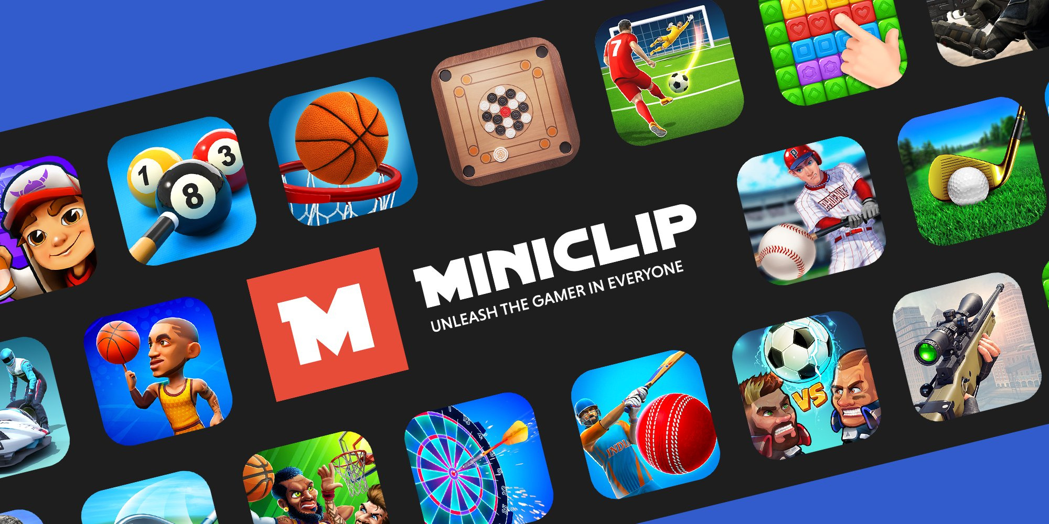

MINICLIP
"Gaming is not just about winning, it's about the journey."
By:- Khushi Patil

Slide 2

Introduction to MINICLIP
Miniclip is a renowned online gaming platform that has captured the hearts of millions of gamers worldwide. Founded in 2001 by Tihan Presbie and Robert Small, Miniclip has since become a household name in the realm of casual online gaming. With a vast and diverse library of free-to-play games, Miniclip offers an engaging and entertaining experience for players of all ages and interests.

Slide 3
Purpose to choose miniclip
The purpose of using Miniclip can vary among users, with many seeking entertainment and fun. Miniclip offers a diverse range of games across different genres, catering to various preferences. It is renowned for its casual games that are easy to start playing. Miniclip's multiplayer games facilitate social interaction. It's free to use, attracting those who want gaming without purchasing games or subscribing.
To enhance Miniclip:
Increase Game Library: Expand the game collection for a more diverse gaming experience.
Fix Account Issues: Address errors when opening accounts to improve user experience.
Improve Social Features: Enable easier connection with friends, achievement sharing, and multiplayer gameplay for a more interactive experience.

Slide 4
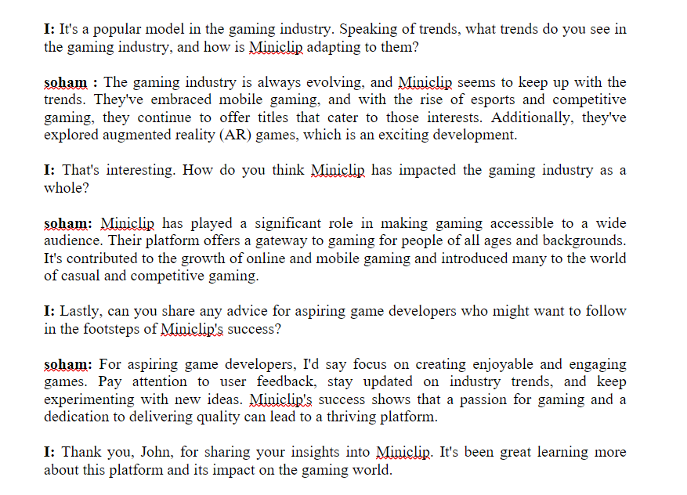
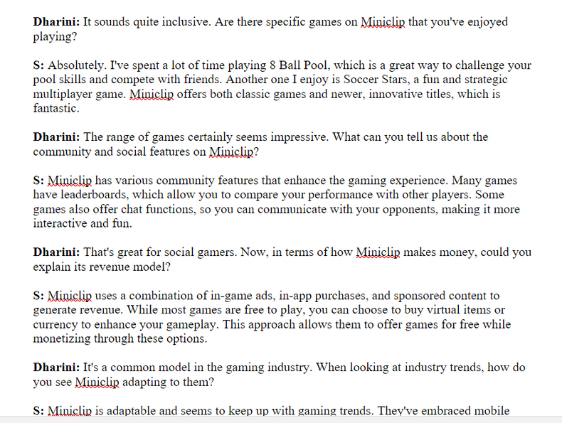

Interviews
First we conduct interview with the soham(neighbour’s child age 11).
Second we can conduct interview with the sarah (age 14)

Slide 5
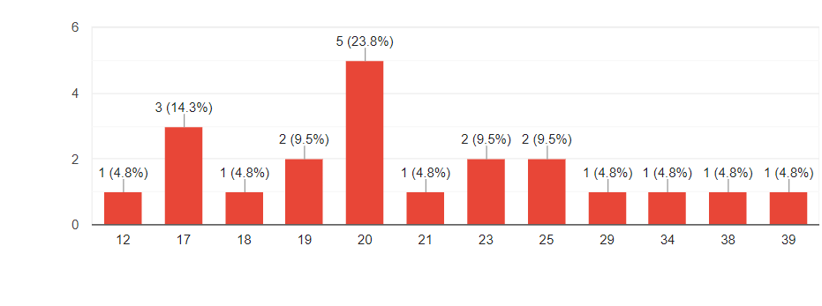
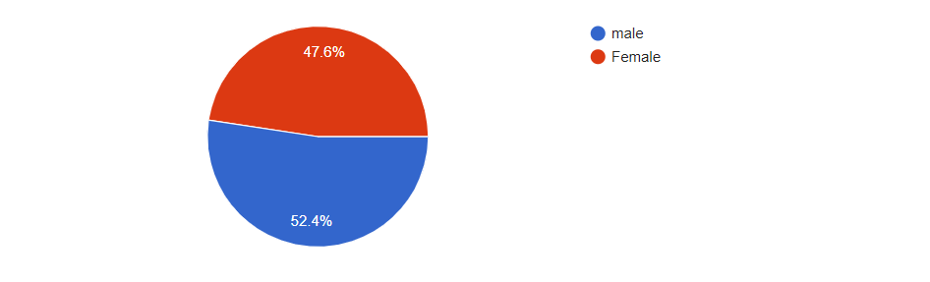
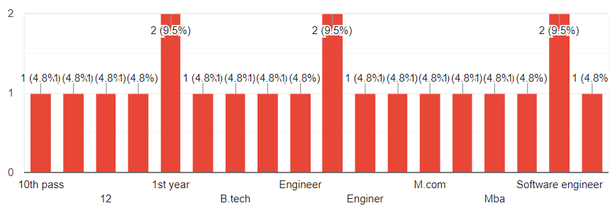
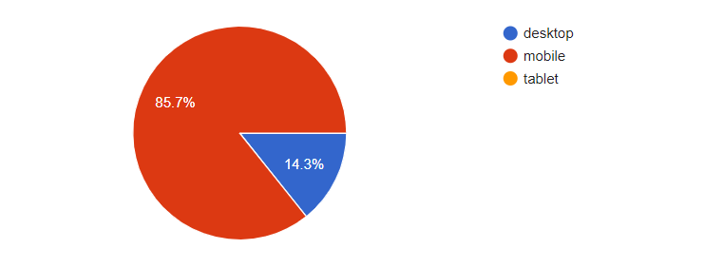
Google forms
What is your age?
What is your gender?
What is educational background?
what device do you access our
website/platform?

Slide 6
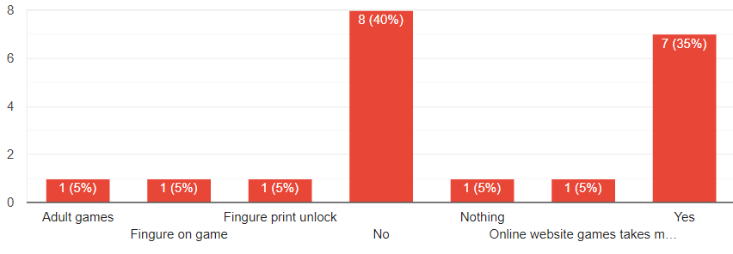
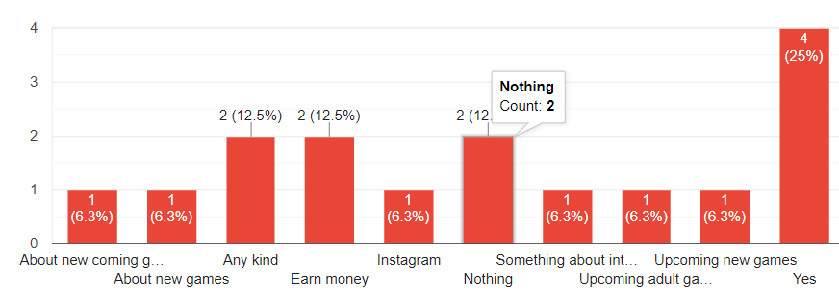
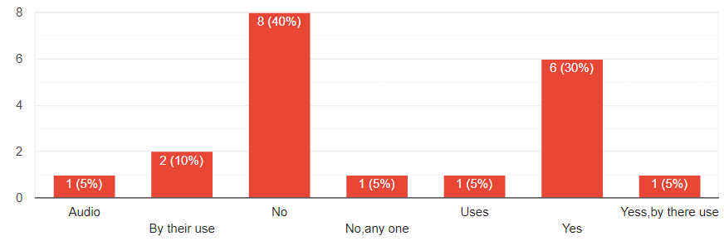
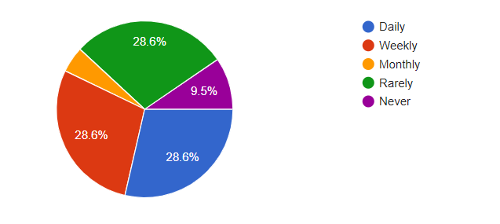
Are there any new features or functionalities you would like to see added?
what kind of notifications or updates are you interested in receiving?
Do you use similar websites or platform? How do we compare to them?
How often do you visit website similar to Miniclip or play such website games?

Slide 7
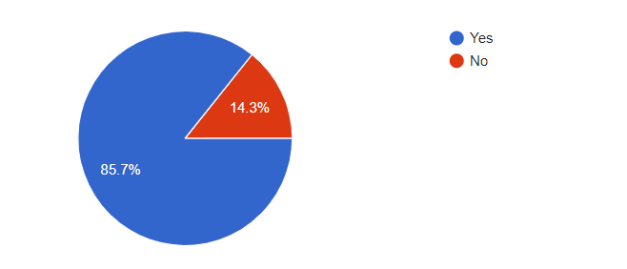
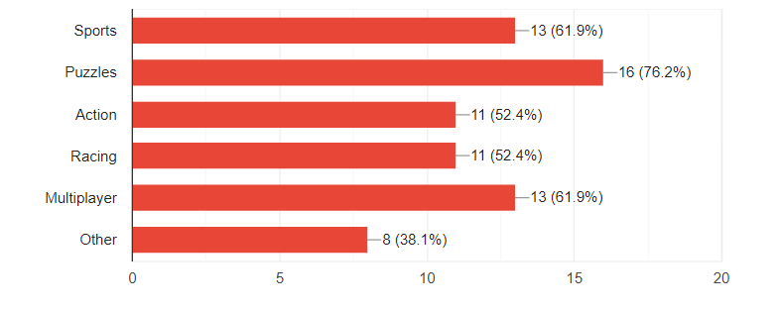
Would you like to subscribe to Miniclip's newsletter to receive updates about new games and promotions?
What type of games do you prefer to play on Miniclip?

Slide 8

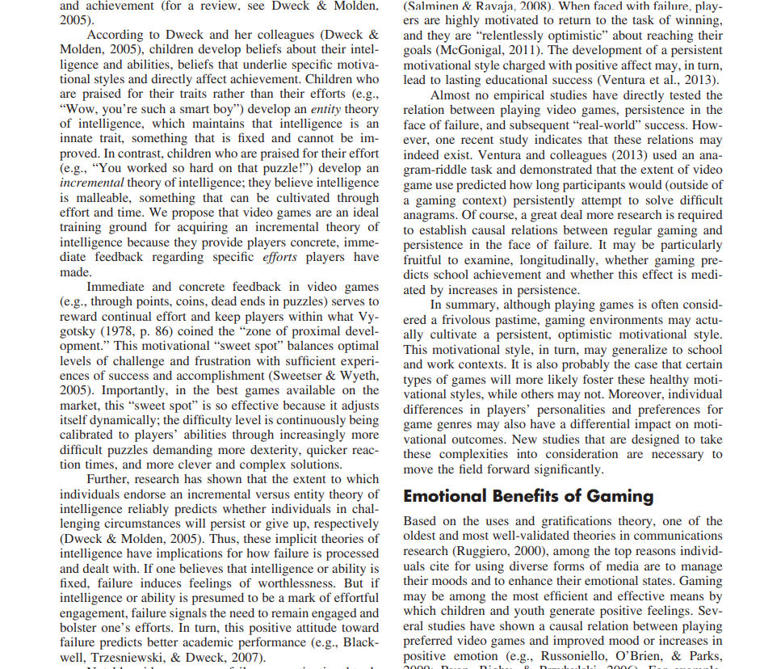
Research paper
MINICLIP

Slide 9
Targeted users
Casual Gamers: Miniclip's extensive library of easy-to-play and quick-to-learn games appeals to casual gamers looking for short bursts of entertainment during breaks or leisure time.
Mobile Gamers: The availability of Miniclip games on iOS and Android platforms makes it attractive to mobile gamers who enjoy playing on smartphones and tablets.
Web Gamers: Miniclip's roots as a web-based gaming platform continue to attract users who prefer playing games in their web browsers on desktop and laptop computers.
Multiplayer Enthusiasts: Many Miniclip games offer multiplayer modes, making them appealing to gamers who enjoy competing against friends or other players worldwide.
Sports and Racing Fans: Miniclip has a wide selection of sports and racing games, making it a go-to platform for users who have an interest in virtual sports and racing simulations.

Slide 10
Users need
How to Know if game is good: Miniclip offers a wide range of games across different genres, but players what to know if the game is good or not.
Free-to-Play: Many of the games on Miniclip are free to play, which attracts users looking for entertainment without the need to spend money but they won’t know until they get in game so a pre-knowledge is needed
About game: Miniclip games can be accessed through web browsers and mobile devices, making them easily accessible for players on various platforms so should
Multiplayer Options: Several Miniclip games offer multiplayer modes, allowing friends to compete with or against each other online but there should be section for single as well as multiplayer games
Proper Record: Miniclip lets users to engage in many game so there needs a record for games played
Career: Miniclip should have a proper way to let users know if they can ever work with their favorite gaming sites.
Contact page: There needs to be a proper way to drop queries or suggestions to the developers of website.

Slide 11
Problem faced while developing
Responsiveness: Making the interface look good and work properly for large screens (like desktops).
Cross-Platform Compatibility: Ensuring the interface works on various operating systems like iOS and Windows.
User Experience: Designing a smooth and intuitive user experience can be challenging, as it requires understanding user preferences.
Keeping up with Trends: Staying updated with the latest design and technology trends to keep the interface relevant and appealing to users.
Performance Optimization: Optimizing the interface for fast loading and smooth interactions, even with slow internet connections or older devices.
Content Management: Handling and displaying large volumes of dynamic content

Slide 12
Gamers Recommendation
Proper interface
Different page for single player and multiplayer game
Paid & Free
About game
Rating
Career
Record
Smooth working of site by page switching and good contact with developer

Slide 13
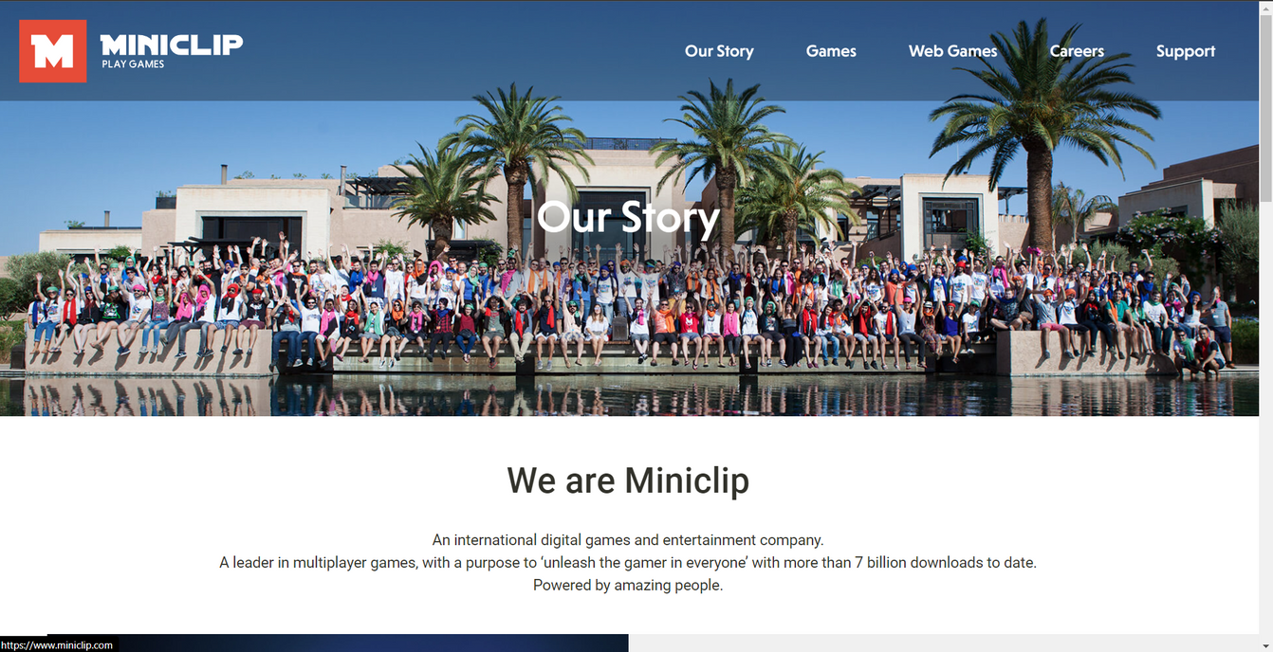

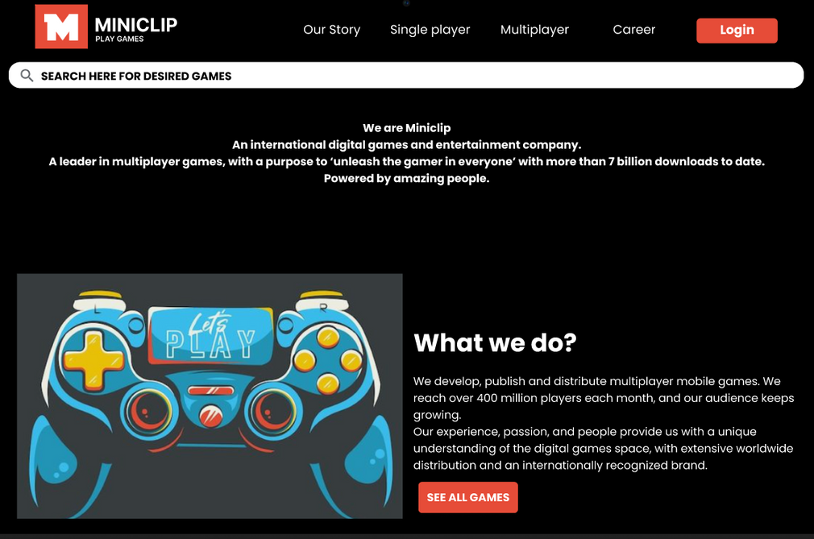
LET’S RELIVE OUR CHILDHOOD AND REVIVE MINICLIP

Slide 14
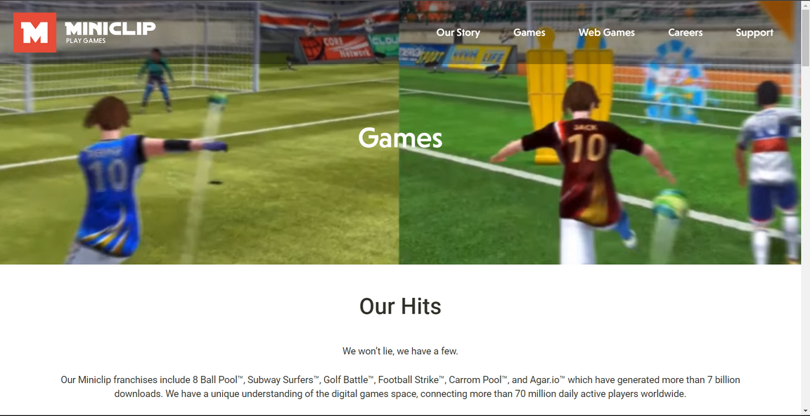
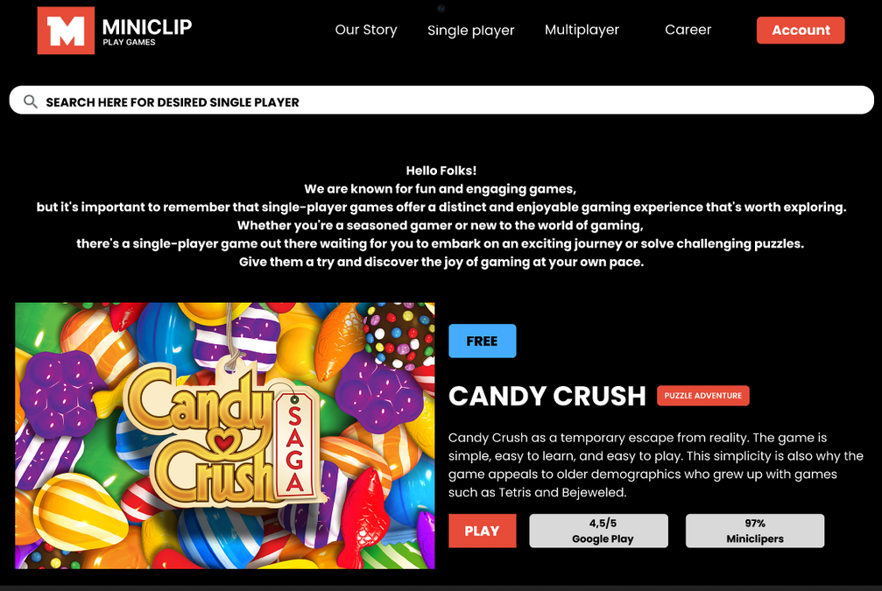

Slide 15
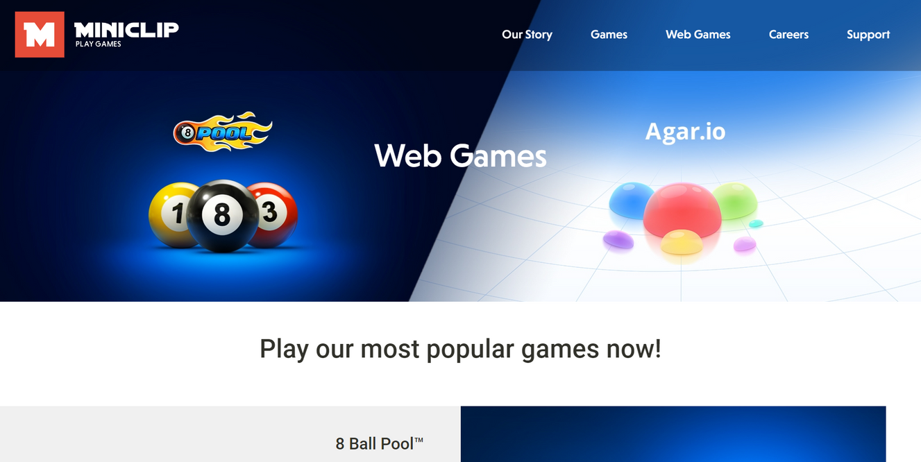
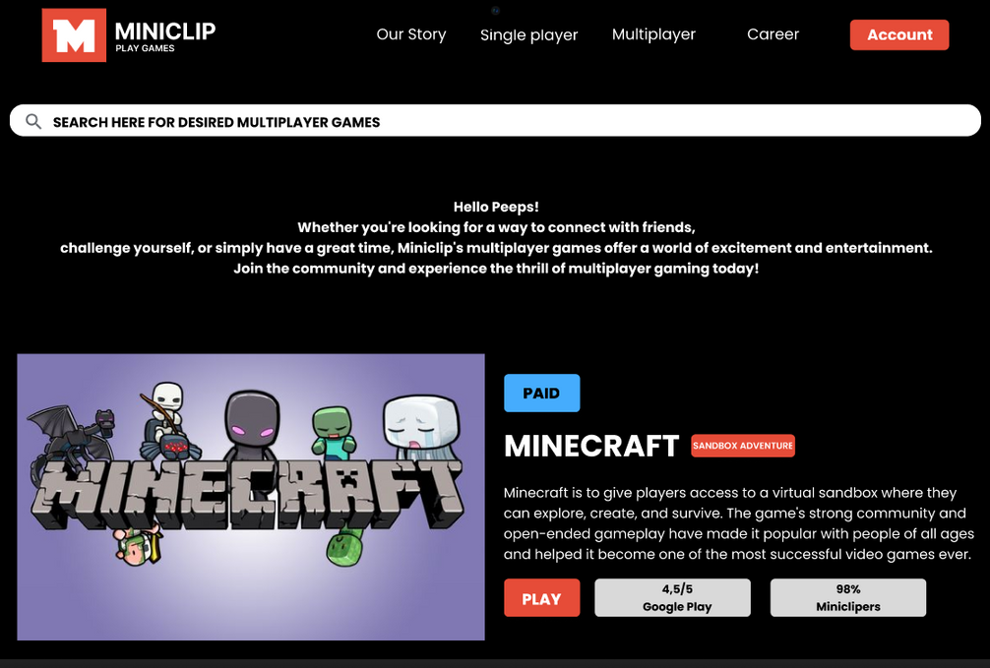

Slide 16
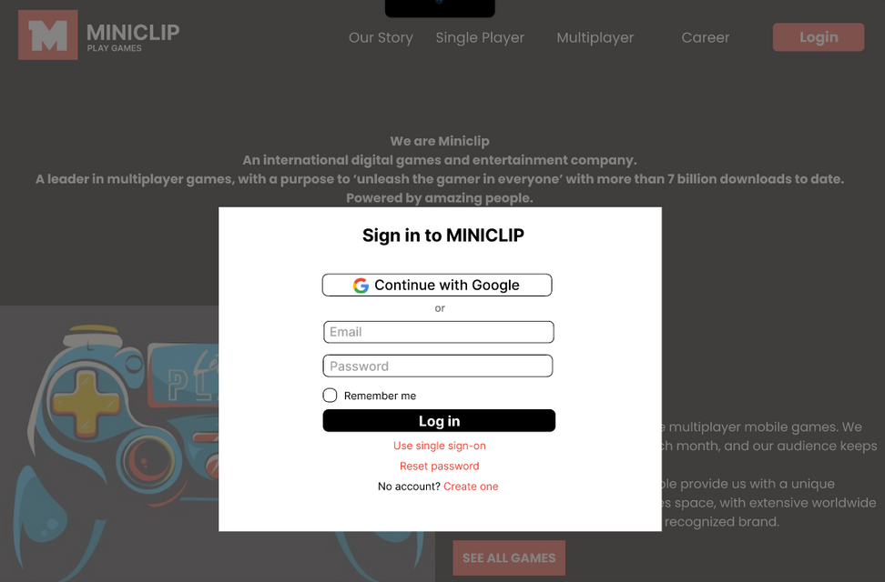
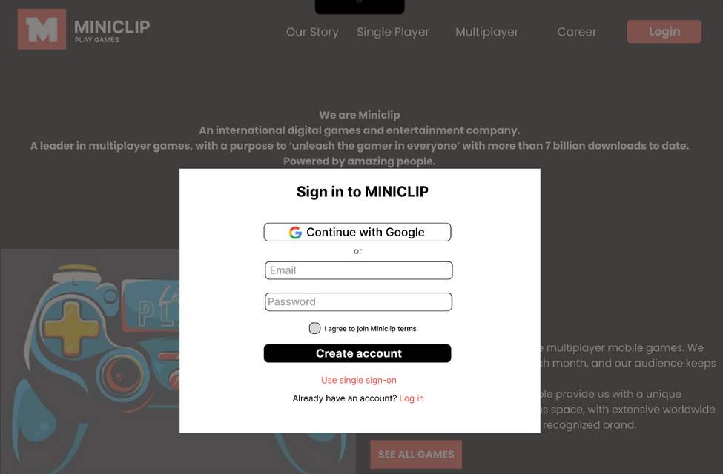
LOGIN ACCOUNT
CREATE ACCOUNT

Slide 17
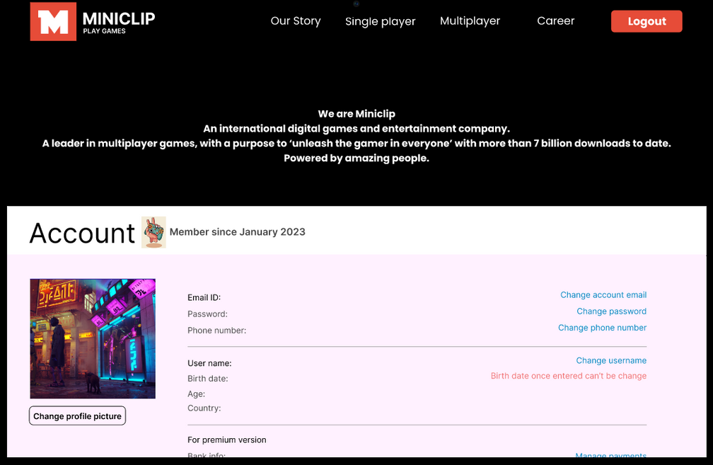
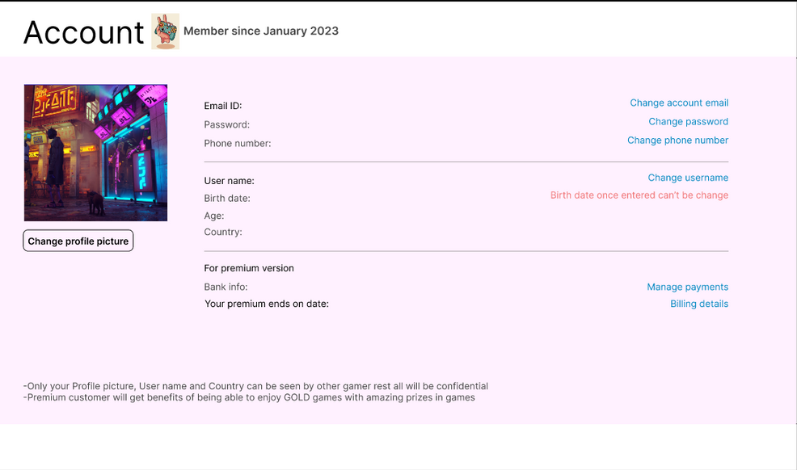
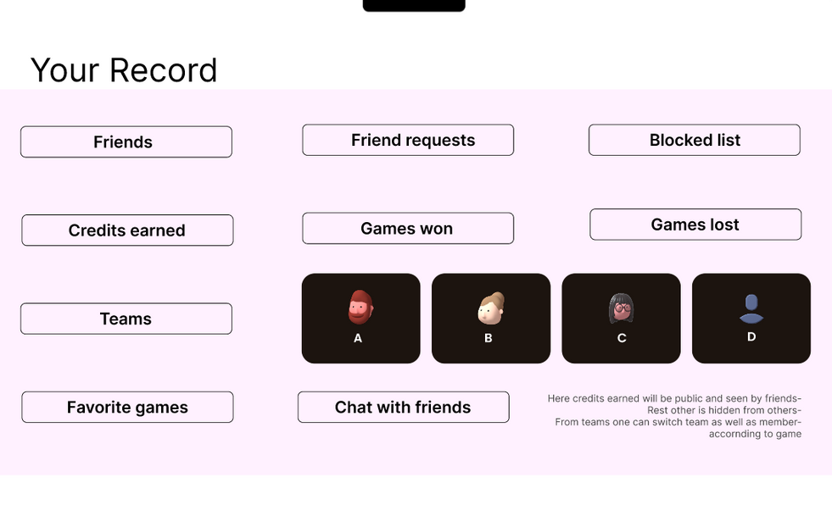

Slide 18
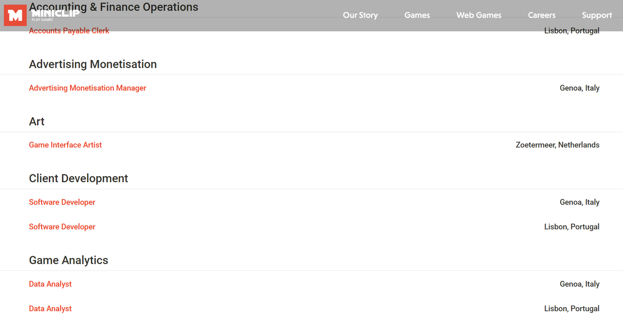
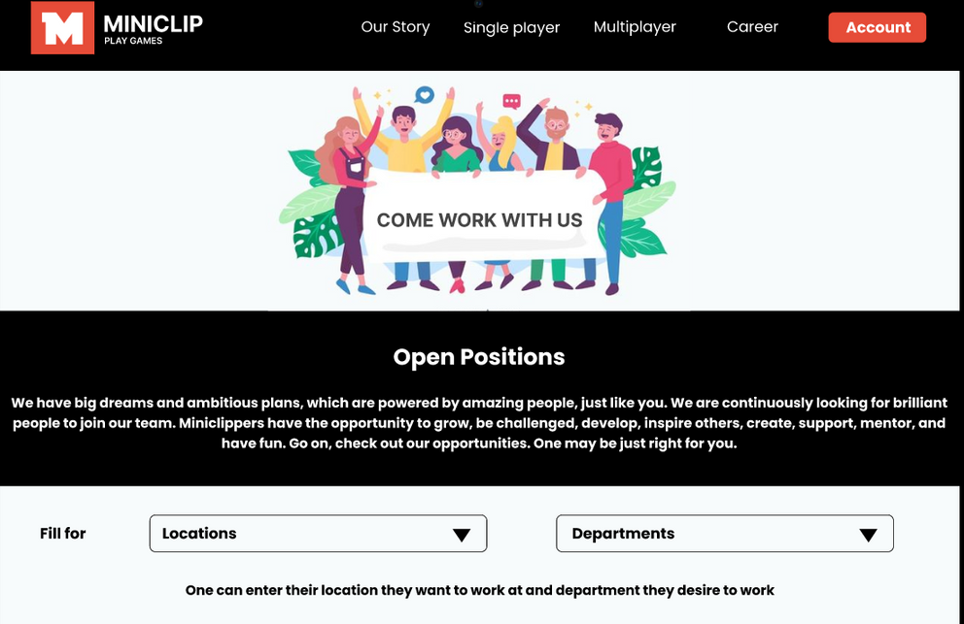

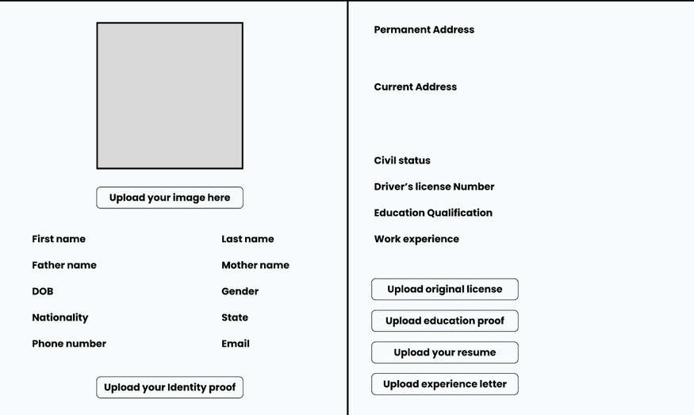


Slide 19
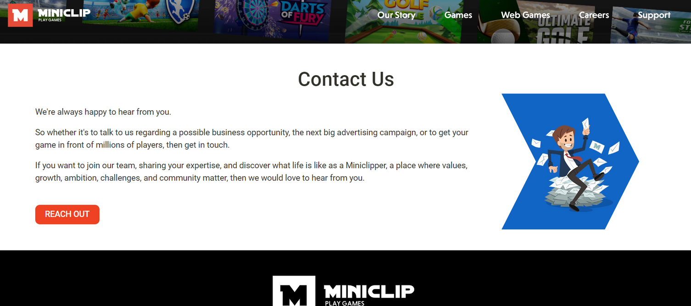
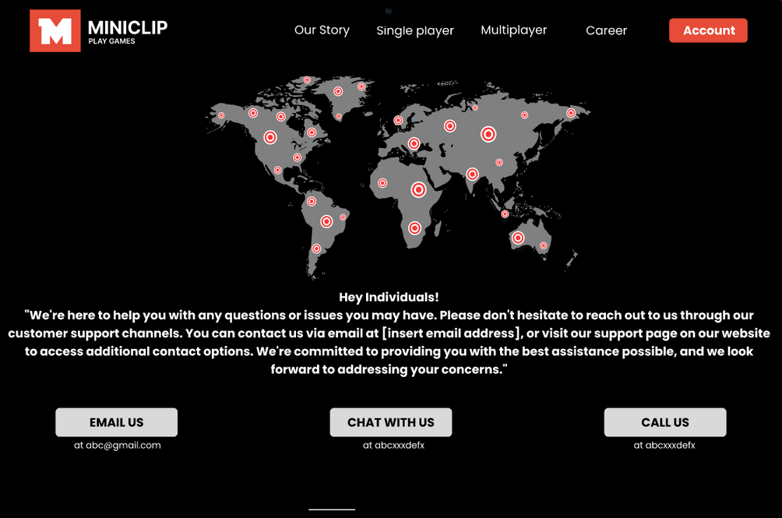

Slide 20
Conclusion
The site went off but the memories still lives in hence it was an idea to make the redesign the site so that it can compete back like it used to back 15 years ago.
Understanding the users requirement we make the amends and try building a smooth working prototype which satisfies most of the request made by users.
On the journey we came how the process of building a project works and across Figma an amazing tool which gave wings to our ideas and help us building such model.

Slide 21
THANK YOU!

